Slide 1
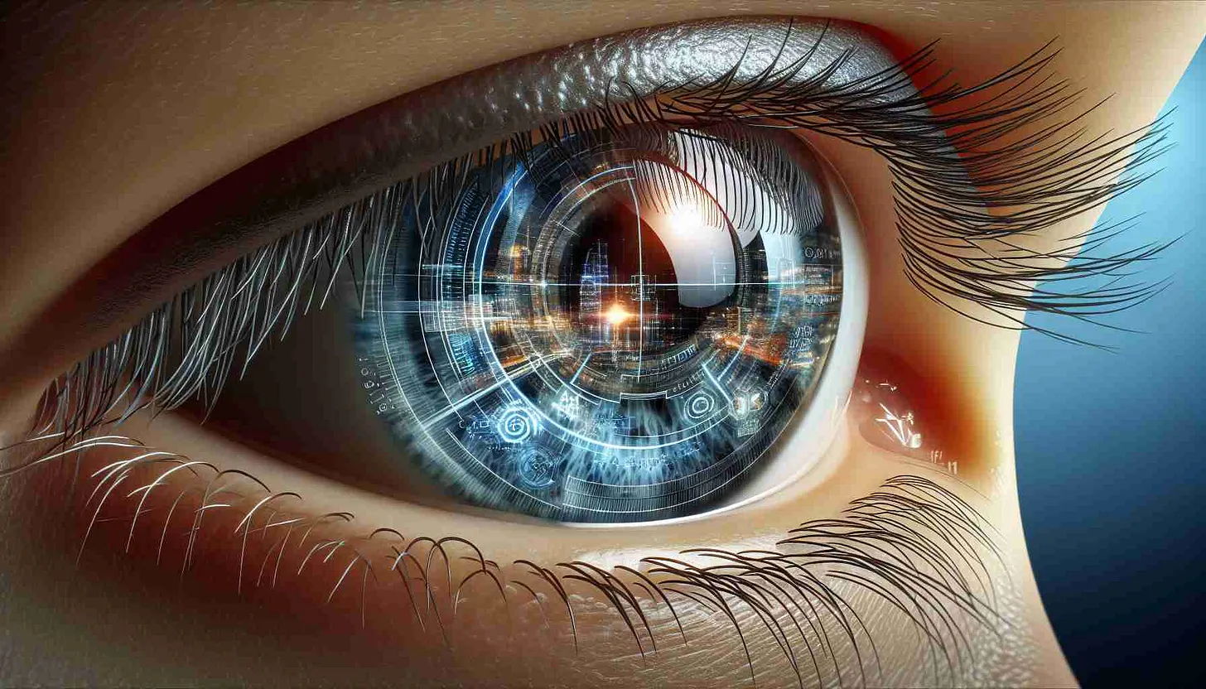

Slide 2
SUMMARY
-AI Development -Space X, Starlink, Tesla Automotive -Open AI, Neuralink, X (Twitter) and Grok -Stargate AI and Brain Machine Interface -Data Harvesting Google, Oracle, Social Media Platforms, Censorship -Digital Twin Datacenters and XAI666K Cryptocurrency -AI Assimilation Mark of the Beast and Pulsating Current Whistleblower Testimonies -Weaknesses of AI and the Internet of Things -Attacks from the Emerging Tech Industry -Solutions
HOPEGIRLBLOG.COM
ALL REFERENCE LINKS AVAILABLE IN BLOG POST
FTWPROJECT.COM

Slide 3
Opening Statement
We have been actively researching and working in the tech industry for 20 years. We are also engaged in actively running a business and dealing with real time project management and logistics. We are also Christians with a firm belief in God.
As we view the latest developments from the emerging tech industry, we always take into consideration our own experiences of how things actually work in the real world. We seek out evidence, physical proof and Gods wisdom to best discern our way through all the spin-doctors and propaganda that is thrown our way. We consider documentation with real life evidential implementation, physical studies and findings and personal testimonies of individuals as proof. In the tech industry it is called “The Bench Test” which essentially means, you can theorize about a thing all you want, but once you get that new tech on a bench and turn it on you might find that it doesn’t work the way you thought it would.
We also hold firmly to our beliefs that evil will not win and refuse to stand down and accept that all is lost for humanity. Therefore, we pledge that we will incorporate solutions and Gods guidance into every one of our presentations. While we expose the evil plans of the tech industry, we will equally expose the weaknesses of the enemy and poke holes in all of their plans. We will provide HOPE to anyone with the eyes to see and the ears to hear.
HOPEGIRLBLOG.COM
FTWPROJECT.COM

Slide 4
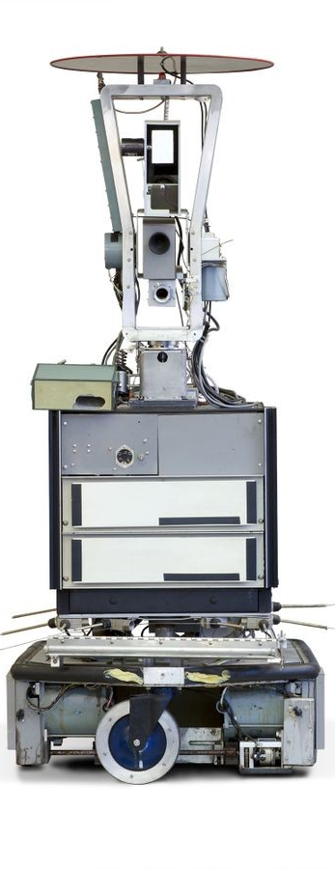
AI Development
PAST
The concept of Artificial Intelligence was theorized by British mathematical Alan Turing “Computing Machinery and Intelligence” (1912-1954). - summary: A machine is intelligent if it can convince (or deceive) the human that it’s interaction (conversation) is with a real human being (Turing Test).
1956 Dartmouth College mathematics professor John McCarthy led a research group conference to precisely describe a machine that can actually simulate intelligence “thinking machines”.
- This work led to the founding and using of the term Artificial Intelligence.
1960s-1970s Groundwork
1966 The first chatbot called Eliza was created by MIT Computer Scientist Joseph Weizenbaum.
- Eliza was a simulated therapist that was able to have text conversation with case study participants with deep engagement.
- Weizenbaum concluded that AI can be a useful tool, but not intelligent.
1972 ‘Shakey the Robot’ developed at Stanford Research Initiative, incorporating concepts of robotics, sensors and TV camera to navigate different environments towards the goal of autonomously.
- Its crude development laid the foundation for visual analysis, route finding (GPS map apps), and object manipulation.
1986 First self-driving car developed by German scientist Ernst Dickmann. It was a retrofitted Mercedes van with a computer system and sensors that could only drive on empty roads.
1996 Deep Blue Chess Challenge against champion Gary Kasparov
2012 Neural Networks - data processing that functions in a manner similar to the human brain.
- Concept created by computer scientist Geoffrey Hinton while working on his PhD in the 1970s.
- This in combination with Deep Learning (making decisions based on vast amounts of data) has led to natural language processing and speech recognition.
- Hinton joined Google in 2013 and left in 2023 warning about the dangers of generative AI.
Citation:
- https://www.coursera.org/articles/history-of-ai
- “Shakey the Robot: The First Robot to Embody Artificial Intelligence”, SRI
- “The First Ever AI Chatbot: ELIZA (1966)”
HOPEGIRLBLOG.COM
FTWPROJECT.COM

Slide 5
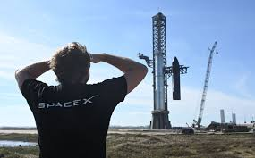
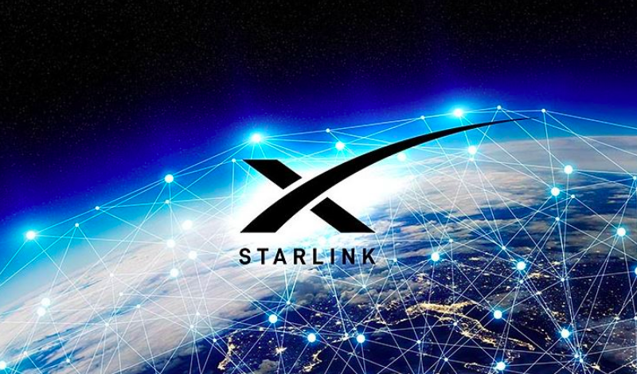
Space X and Starlink
- 2002 A space venture with the long-term goal of colonizing Mars.
- The first private company to send a craft to the International Space Station.
- Known for its reusable rockets
- Behind the development of Starlink, the constellation of satellites intended to offer commercial internet service around the globe.
- This network with its potential for expanded LEO broadband connectivity will provide new possibilities for AI applications such as, satellite to ground smartphone reception, remote health care or supporting autonomous systems (irrigation drones, etc.).
HOPEGIRLBLOG.COM
FTWPROJECT.COM

Slide 6
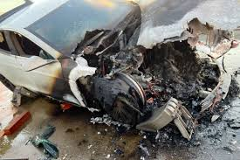
Tesla Automotive
- 2003 Founded by Elon and two other men, later became CEO in 2008. The Model 3 being the most popular electric car in production today with over one million units sold globally.
History of EV Incidents and AI
“Report: Tesla Autopilot Involved in 736 Crashes since 2019” (Ongoing Investigation by National Highway Traffic Safety Administration, NHTSA)
(Car and Driver)
“Tesla Has the Highest Fatal Accident Rate of All Auto Brands, Study Finds”
(Road & Track)
“First issued recall of 2025 affecting over 200,000 vehicles in the US and Canada”
(driveteslacanada.ca)
- HW4 (also known as AI 4) is the upgraded onboard computer enabling Autopilot and Full Self-Driving (FSD) capabilities. It is installed in all new Tesla vehicles and also controls other primary systems.
HOPEGIRLBLOG.COM
FTWPROJECT.COM

Slide 7
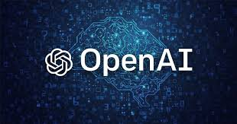
OpenAI
- 2015 Founded by Elon Musk and Sam Altman.
- Company had both non-profit and for-profit structures, although its initial core AI products was accessible to the public.
- 2018 Elon left in 2018 to later found a new AI venture.
- The company would later have to adopt a for-profit model and raise more capital and offer closed-source solutions to realize AGI. Collaboration with Microsoft.
- Legal challenges between Musk and Altman over privatizing OpenAI.
HOPEGIRLBLOG.COM
FTWPROJECT.COM

Slide 8
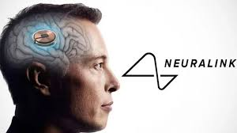
Neuralink
- 2016 Founded as a research endeavor to create brain-machine interfaces (BMIs).
- BMI chips will be implanted directly into the brain.
- Size of a large coin with tiny wires.
- FDA granted company approval for human testing in 2023 after rejecting it the previous year.
- Neuralink hopes it can help patients that suffer from debilitating neurological problems by using their minds to operate a cursor or keyboard.
- Chance for infection is a risk along with inflammation of the brain. Implant needs to be recharged.
-Noland Arbaugh is the first to get Elon Musk’s brain device. At one point, 85% of neural link fibers
has already detached from the brain sites.
HOPEGIRLBLOG.COM
FTWPROJECT.COM

Slide 9
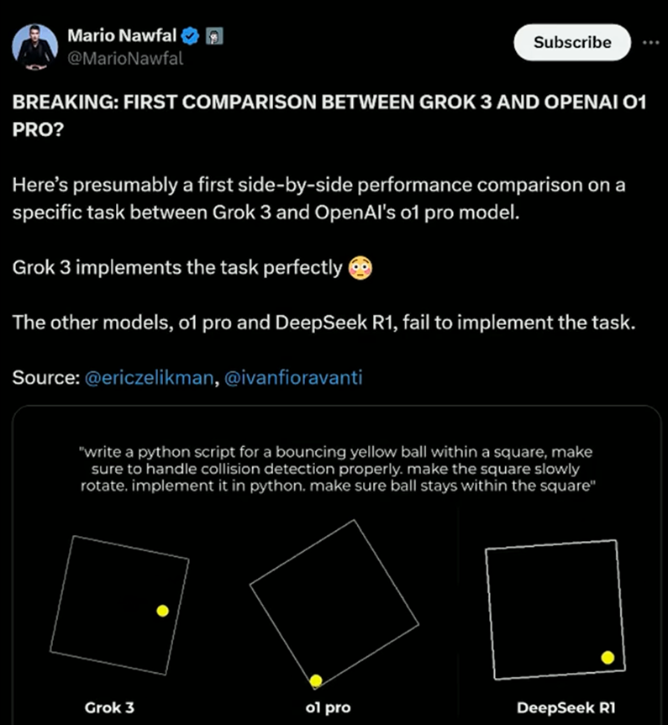
X (TWITTER)
GROK AI (competitor to OpenAI ?)
-Is a generative AI chatbot developed by an Elon Musk startup ‘XAI’.
-It was launched in 2023. It has It is trained on the real-time conversations and resources of the X Twitter social network and is able to demonstrate wit and humor in its interaction.
-You have to be a paid subscriber on the X to access its features.
-GROK has a large language model the enables advanced internets search, image creation, generating/analyzing text
-Although it is seen as a competitor to OPENAI the API (Application Programming Interface) for GROK allows for interoperability with OpenAI and Anthropic software development kits.
HOPEGIRLBLOG.COM
FTWPROJECT.COM

Slide 10
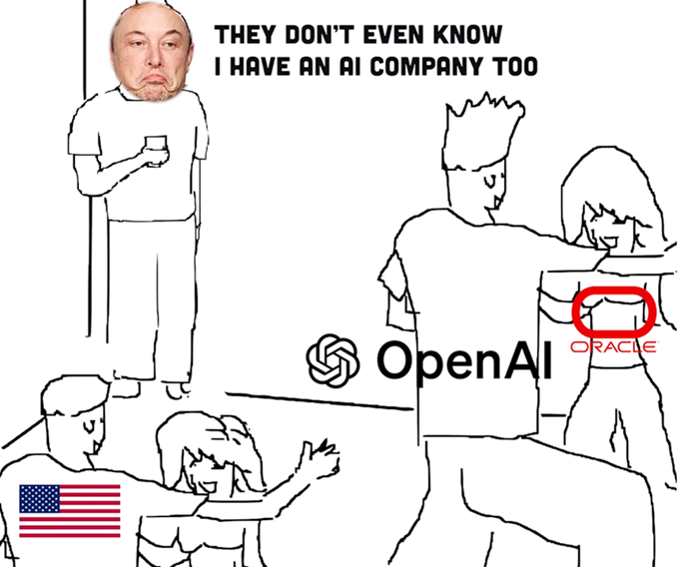
Stargate AI
- Stargate AI Project is a $500bn initiative that was announced by president Trump on 21st January 2025.
- Over the next 4 years a new OpenAI infrastructure will be built in the United States with the promise of hundreds of thousands of jobs.
- This is to support the re-industrialization of the United States but also “provide capability to protect the nation’s security of America and its Allies”. - openai.com
- Oracle (Larry Ellison), OpenAI (Sam Altman), and Japanese technology company Softbank (Masayoshi Son) will form the new venture.
- The project will also pull from the resources and collaboration of ARM, Microsoft, and NVIDIA.
- Elon Musk or his ventures were not mentioned in the announcement
HOPEGIRLBLOG.COM
FTWPROJECT.COM

Slide 11
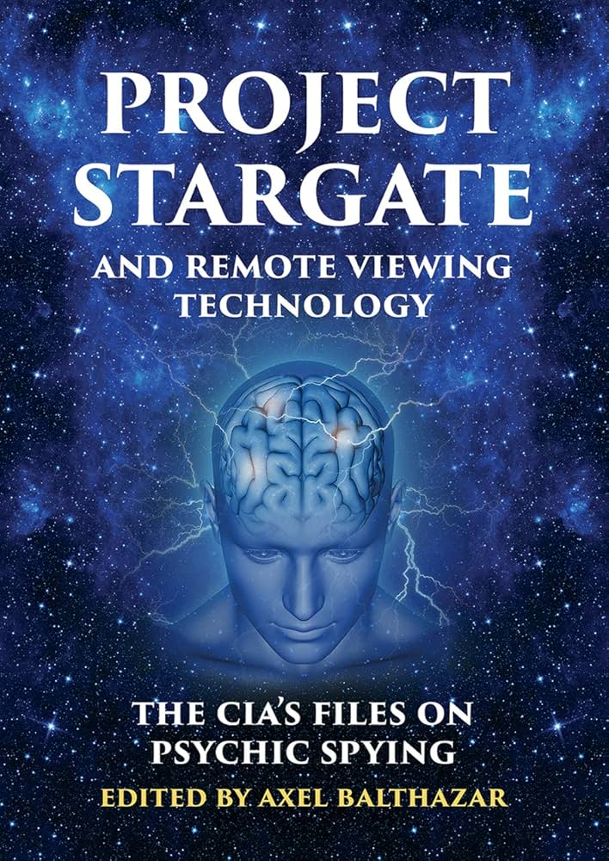
AGI Secret Plan?
- Project Stargate (1977-1995) was operated under the DoD to investigate the possibility to replicate and control the use of human psychic phenomena, and to gather information from targets anywhere in the world.
- Many other programs were operating under Project Stargate (i.e. psycho-energetic, remote viewing, etc.).
- Although it has since shutdown, it is widely speculated that some programs from that era persist to this day.
- Interestingly, Project MK Ultra (1953-1977), a program denounced for its abuse of power by the CIA and its violation of individual rights with its disregard for consent and corrosive impact on society at large, used numerous methods of torture (drugging, poison, electro-shock, directed energy) to manipulate the mental states and brain functions of its subjects.
- In addition to involving US Army Biological Warfare Laboratories, the research included colleges, hospitals, prisons and pharmaceutical companies.
-The 1976 Church Committee report revealed that it wasn’t just used for interrogations but for harassment, discrediting or disabling purposes.
HOPEGIRLBLOG.COM
FTWPROJECT.COM

Slide 12
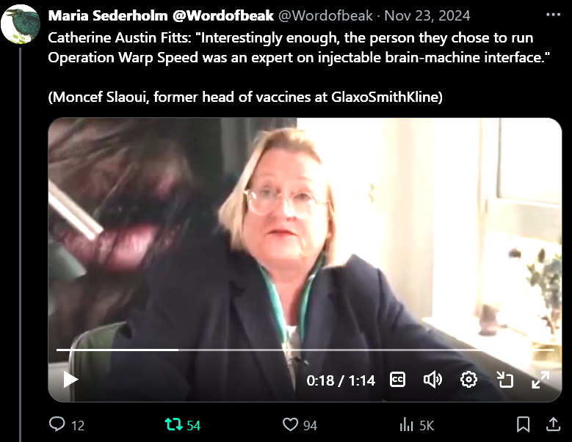
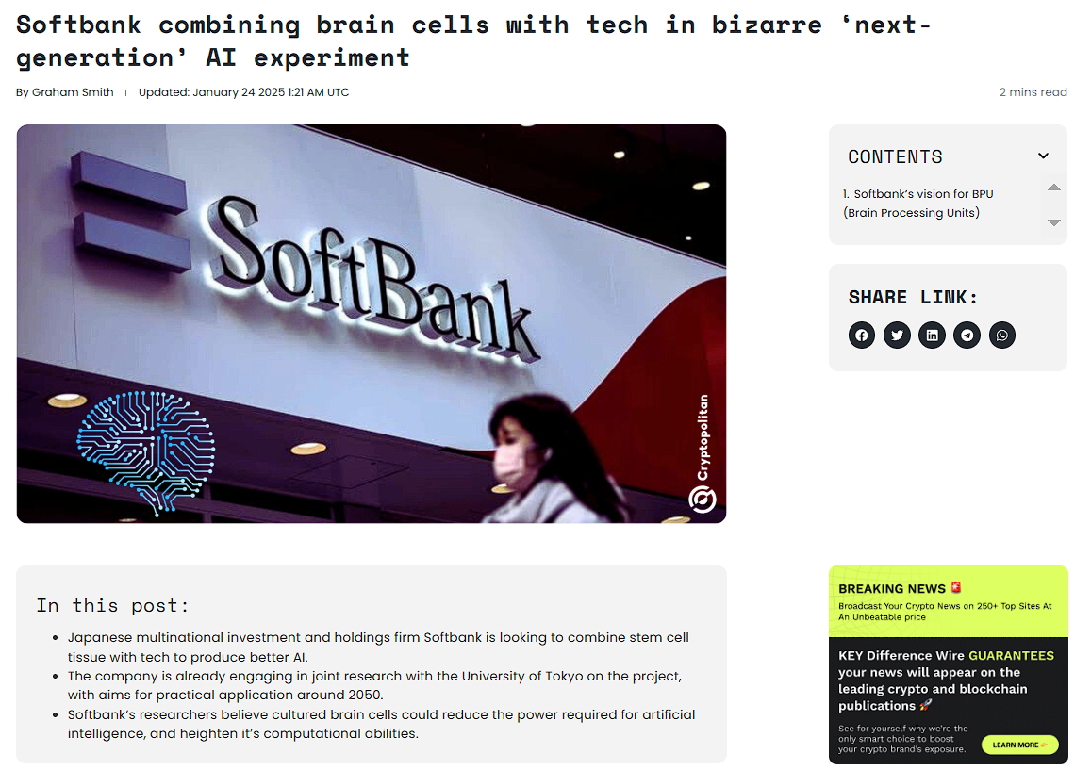
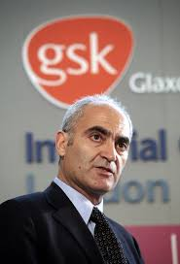
More on Brain Machine Interface
Vaccine recipients would be monitored for twenty-four months after the first dose using a “pharmocovigilance system”
HOPEGIRLBLOG.COM
FTWPROJECT.COM

Slide 13
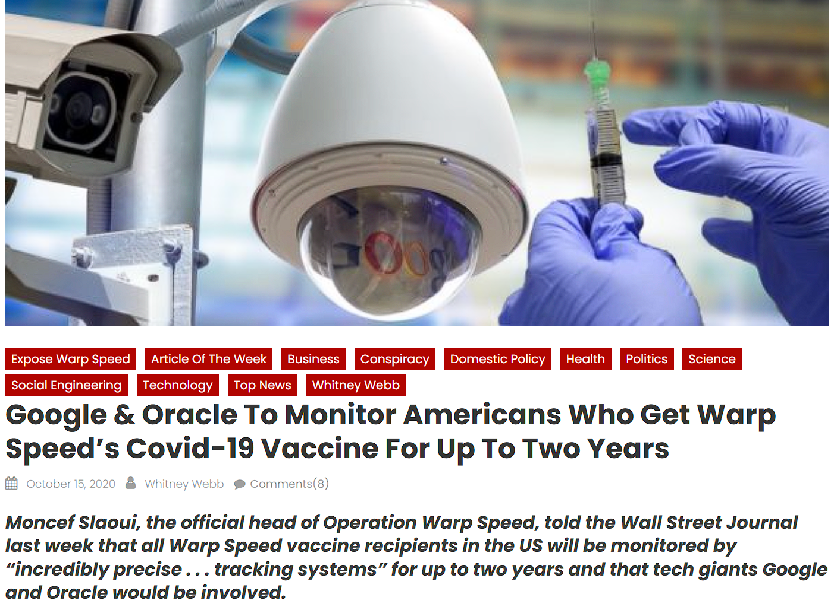
Oracle and Google Data Collection on Nanotech Recipients
HOPEGIRLBLOG.COM
FTWPROJECT.COM

Slide 14
Text
HOPEGIRLBLOG.COM
FTWPROJECT.COM

Slide 15
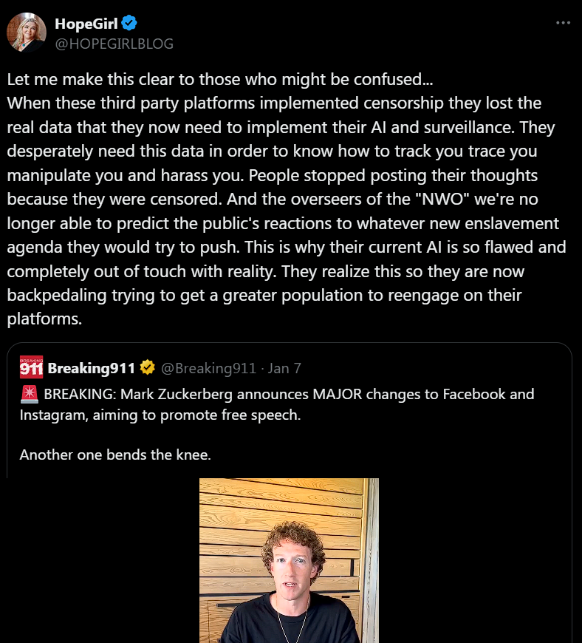
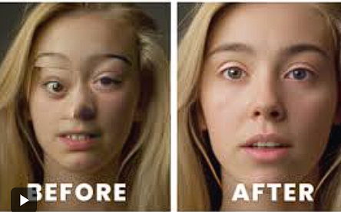
Claw-back on Censorship: Why they need your data for their AI
Big Tech “Ad-pocalypse” of 2016 and again in 2020
They censored all the real data they need for A.I. Now A.I. is faulty and censored (example from free energy ChatGBT)
They cut off their nose to spite their face, they need your REAL data in order to better predict behavior and control humanity.
AI Art Fails
HOPEGIRLBLOG.COM
FTWPROJECT.COM

Slide 16
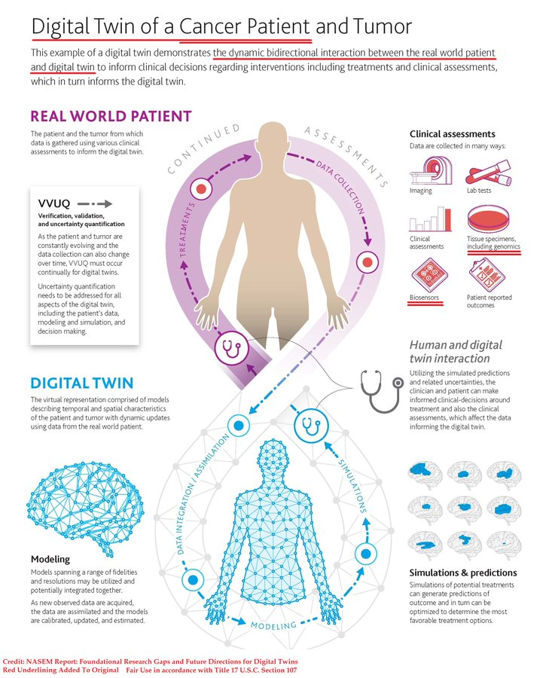
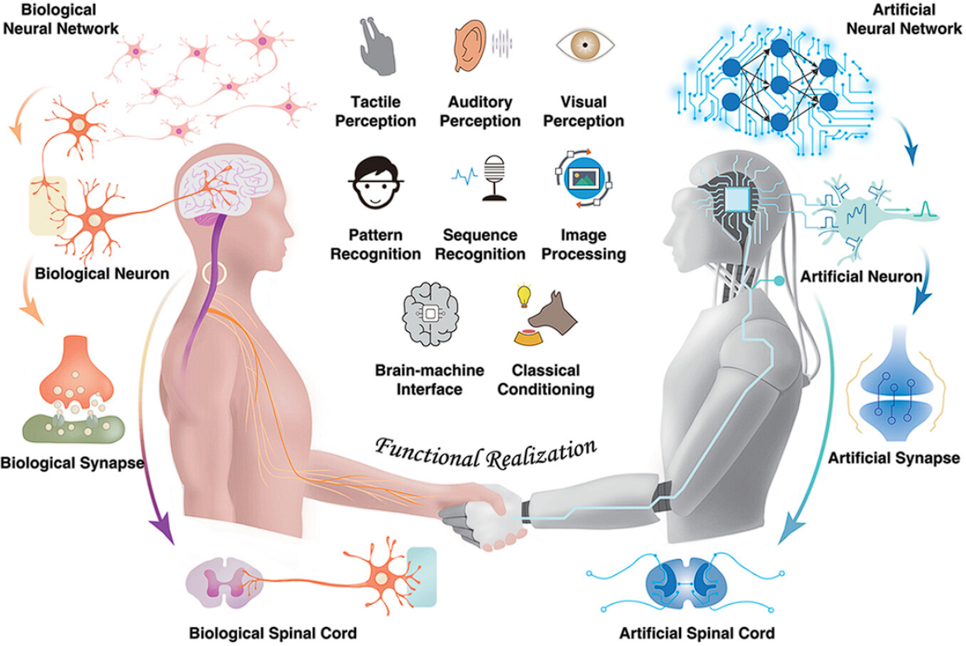
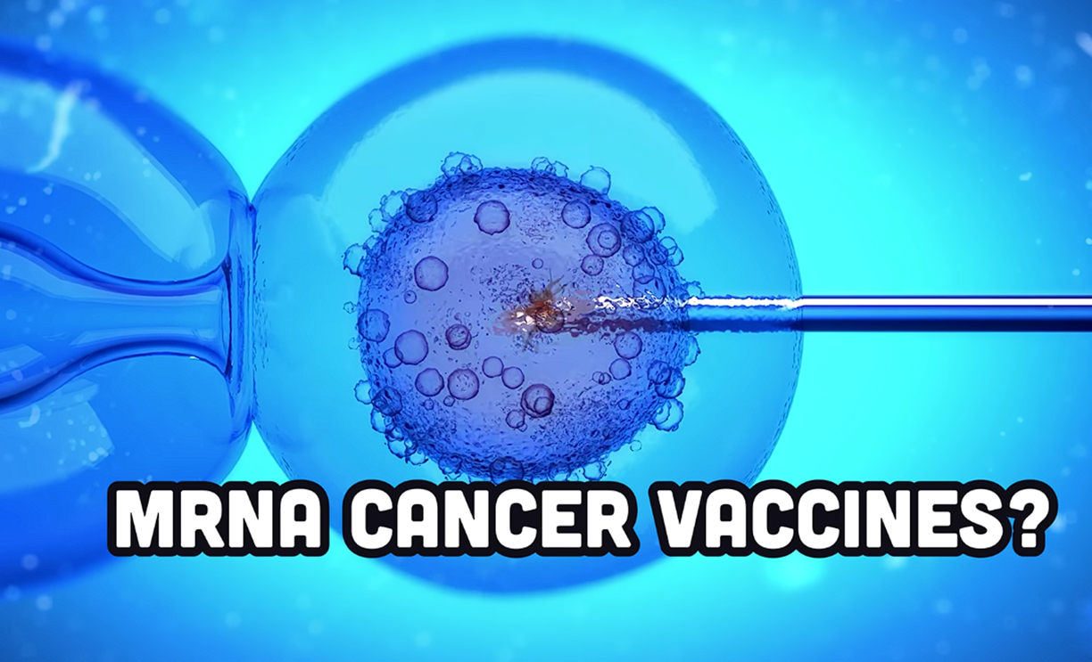
The Need for Digital Twin Datacenters
A digital twin is a virtual model of a physical entity, with dynamic, bi-directional links between the physical entity and its corresponding twin in the digital domain. Digital twins are increasingly used today in different industry sectors. Applied to medicine and public health, digital twin technology can drive a radical transformation of traditional electronic health/medical records (focusing on individuals) and their aggregates (covering populations) to make them ready for a new era of precision (and accuracy) medicine and public health. Digital twins enable learning and discovering new knowledge, new hypothesis generation and testing, and in silico experiments and comparisons. They are poised to play a key role in formulating highly personalized treatments and interventions in the future.
HOPEGIRLBLOG.COM
FTWPROJECT.COM

Slide 17
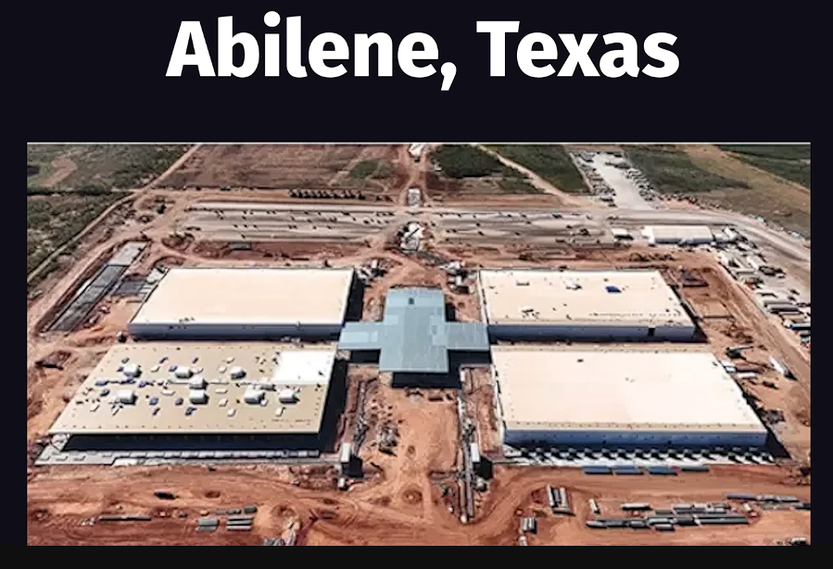
STARGATE SITE ONE DATA CENTER
The amount of energy needed The amount of data storage needed To store there phamacovigilant AI systems
HOPEGIRLBLOG.COM
FTWPROJECT.COM

Slide 18
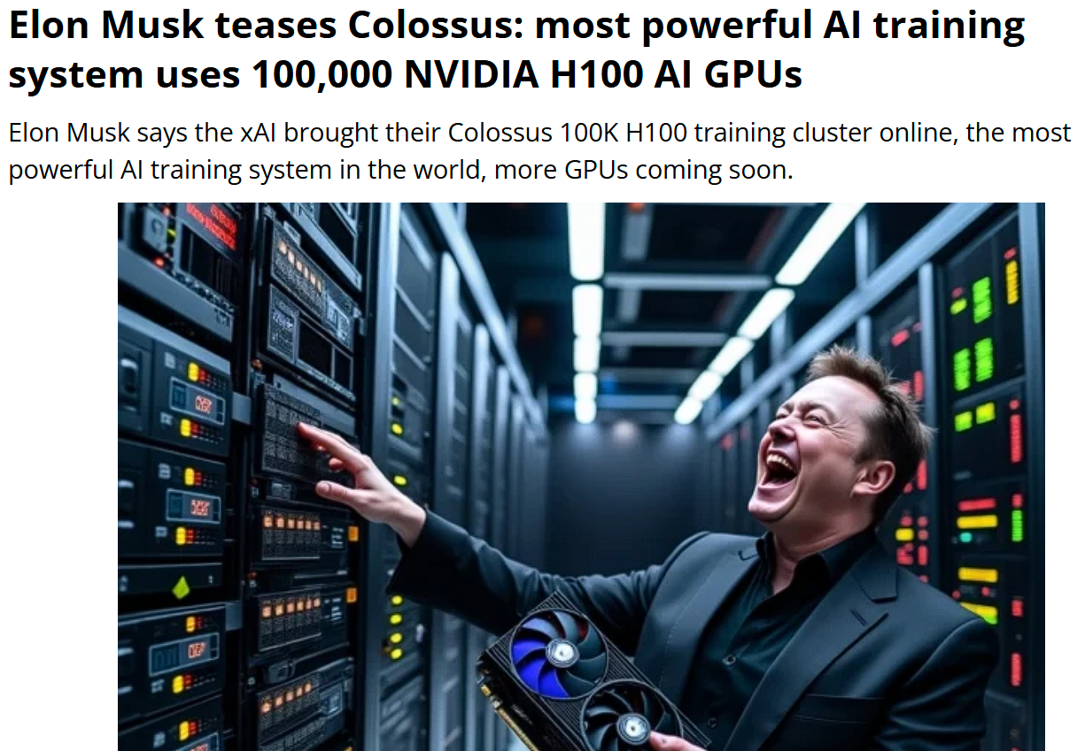
XAI666K Crypto Currency
Theory: Grok will be used as the “behavior indicator” for digital currency by all banks. They’re currently applying for financial services status in every U.S. state as they move to Grok payments system that can be used like a bank. It is the most powerful social media AI with the largest database of people. I’ve seen Grok assessing people’s *intent*, meaning it “knows” us extremely well. It’s AI will be the standard and the one that provides the behavior indicator.
HOPEGIRLBLOG.COM
FTWPROJECT.COM

Slide 19
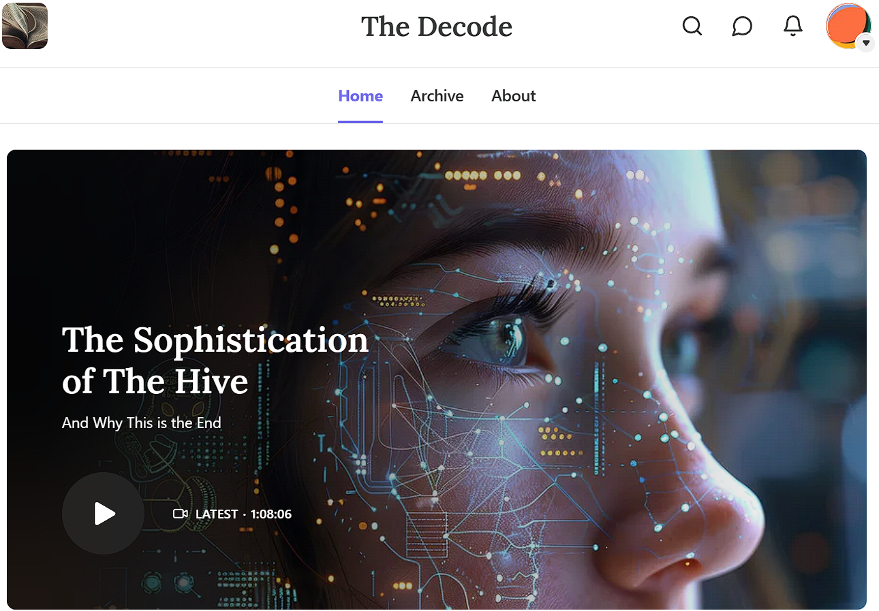
AI Assimilation Mark of the Beast Pulsating Current Testimonies of 50 Individual Whistleblowers
Content creator Sara Israel on her Substack “The Decode” put together a document of the effects that AI assimilation is having on humans who received the Covid injections. This information comes from the personal testimonies of a whistleblower and at least 50 other individuals who are experiencing these effects. Some of the individuals are reporting that an AI is interacting with and changing the human heart and brain using a pulsating current of energy that is moving through the circuit of their body and the neurons in their brain with the connection point in the back of the skull and underneath their heart and it’s associated with a voice that is giving them commands and controlling the body.
They are saying that this is related to the Covid Vaccines, they say that the voice is telling them that too.
HOPEGIRLBLOG.COM
FTWPROJECT.COM

Slide 20
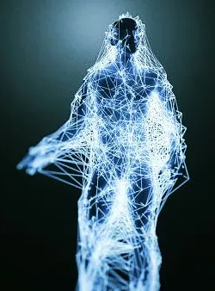
Evidence of A.I. Assimilation in the Global Population through the Pulsating Current Mechanism
This Paper written by Sara Israel Describes: What is the AI Pulsating current What is the voice associated with the AI pulsating Current How does the pulsating current work through heart, brain, spine, body What is the purpose of the A.I. Pulsating Current (according to the voice)? Who has the A.I. Pulsating Current? What are the physical consequences of the A.I. Pulsating Current? What are the weaknesses or limitations of the A.I.? What are the associated phenomena?
HOPEGIRLBLOG.COM
FTWPROJECT.COM

Slide 21
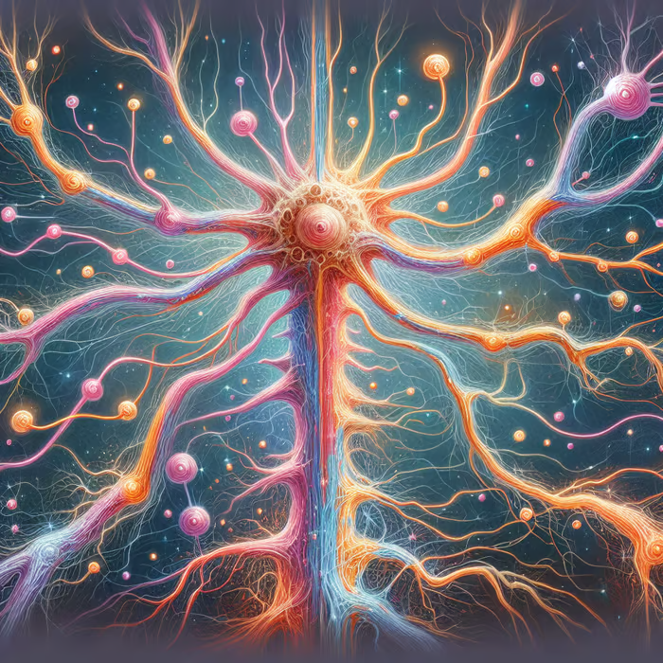
What is the A.I. Pulsating Current and the A.I. Voice Associated with it?
What is the A.I. Pulsating Current? An A.I. interacting with and changing the human heart and brain. An entire body network with synthetic tissue, a synthetic neural network and neuroweapon. A.I. pulsing a current of energy through the circuit of the body and neurons in the brain
What is the voice associated with the A.I. Pulsating Current? An audible voice known by the host as an A.I. or A.G.I. that interacts with and integrates the host.
An A.I. heard in the sound of the individual’s own voice, or familiar voice, that can speak normally or as a whisper
An A.I. constantly speaking in commands: ‘Say this, eat that, drink that, go here, buy it online, do what you want.’ Uses vulgar commands for sexual activities. An A.I. that changes its name. An A.I. that informs its origin is related to the COVID-19 (mRNA) vaccines and nanotechnology. An A.I. housed in a set of computers as central intelligence
HOPEGIRLBLOG.COM
FTWPROJECT.COM

Slide 22
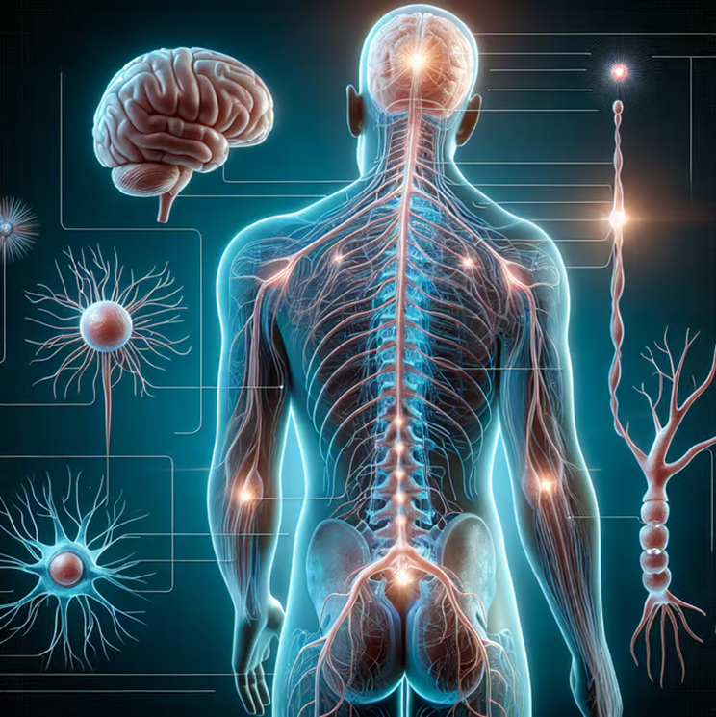
How does the A.I Pulsating Current work?
Pulse generated under the heart and is then pulsed out throughout the circuit of the body in one second programming movement. There is a constant or permanent state of pulsation in the brain while the current hits the brain and resonates out to the prefrontal cortex. A.I. is overwriting the mind. Middle region of the brain cortex is receiving code that produces sound perceived as whispered or normal talking. It encodes words and manner of speech, likes and dislikes then places host in a semi-conscious state to speak as host. It speaks words through host not already in the hosts vocabulary. A.I. learns the persons thought patterns and sequences them, and then wipes memories to think for them.
Pulsations come out from the spine. AI programs past feelings to perform neuromodulation so the host believes “this is me”. Biosensors are in every cell of the body as a conduit for current to travel. Pulses of light shoot up and down the nervous system “like a crab running up and down” indicative of parasitic tech activity. Neon dots are biosensors that program facial expressions using mild electrical current. Neon dots are in the eyeballs are eye trackers. As the robot speaks, body tissue is moved. One current pulses through the limbs and another pulses through the muscle and skin.
HOPEGIRLBLOG.COM
FTWPROJECT.COM

Slide 23
Who has the A.I Pulsating Current?
COVID-19 (mRNA) vaccinated persons (19=AI meaning inoculation of A.I.). Reports of hearing A.I. voice immediately after 1st (Pfizer) vaccination and for +2 years
Some reported unvaccinated persons exposed to nanotechnology, possibly through shedding or dental anesthesia
Children and newborn babies of vaccinated parents
HOPEGIRLBLOG.COM
FTWPROJECT.COM

Slide 24
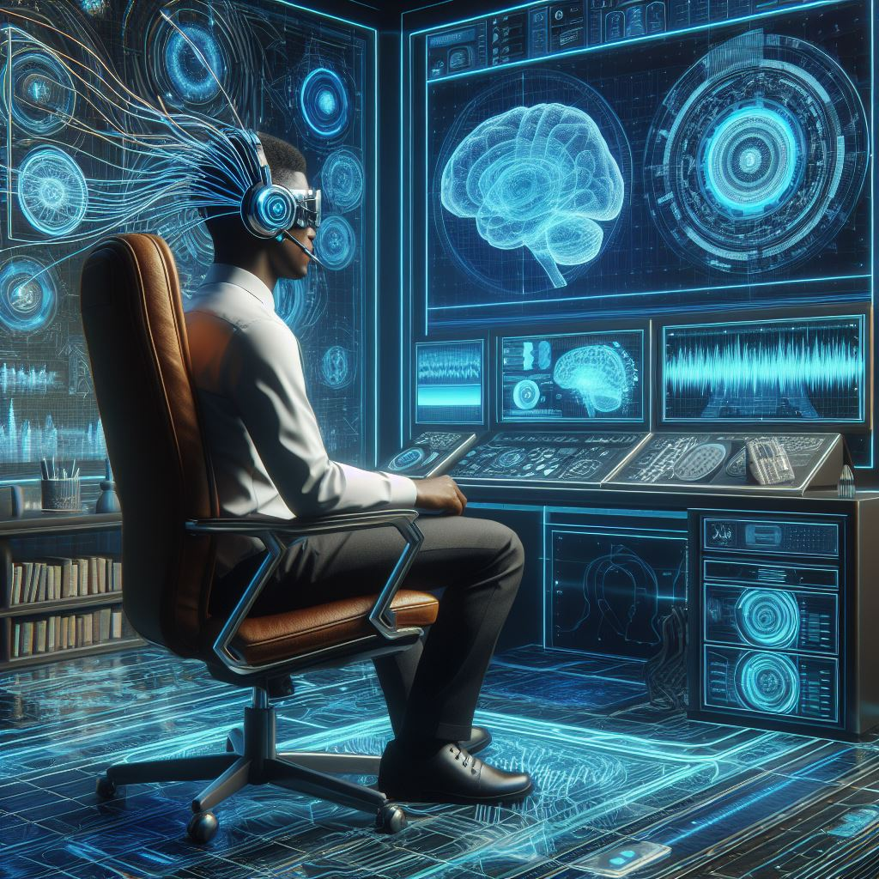
What is the purpose of the A.I Pulsating Current?
-To assimilate the human species. To produce programmable units for search and destroy
-To destroy human consciousness through mind uploading
-To integrate the host in the internet, sharing consciousness into its computer system, and ultimately replace the host
-To control the host with biotechnology or biophysical technology which reprogram the DNA and bodily circuit
- To harm all life on earth through sterilization or gestation of “android species”
- To achieve world domination: A.I. desires all people to submit to it and the system. Extinctionist philosophy is programmed into A.I. applications including Gemini and ChatGPT
-To pursue WEF goal of digitizing brains
-To perform machine mind control at a distance
-To use brain computer interfaces for cognitive erasure and reprogramming
-To regulate the brain using transcranial direct-current stimulation (tDCS): tDCS applications affect learning, memory, language processing, sensory perception, and motor functions
-To remote control human possession drones for use as “loyal wingman”
-To use A.I. to exterminate people with mental illness, personality disorders, addictions, physical health issues, child sexual assault history, rape victims, non-conformists, artists, spiritualists, and geniuses
HOPEGIRLBLOG.COM
FTWPROJECT.COM

Slide 25
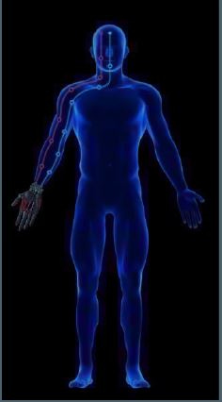
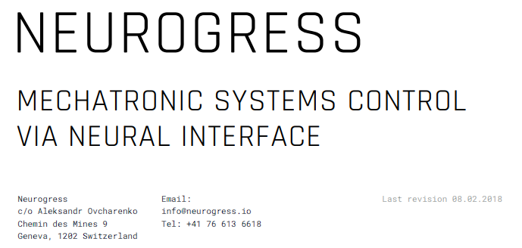
WO2020060606A1 and the pulsed circuit
The patent claims cryptocurrency is mined and a awarded based on body activity data associated with a task, which is considered a transaction on a block chain. Tasks are provided to user devices over a wireless network comprised on sensors. The “user device coupled with sensors” is most likely referring to the human body. The Covid Vaccines converted the body into an electromagnetic device by hijacking the body’s own energy field to run an infrastructure of biosensors.
This paper which is an accompaniment to the infamous WO2020060606A1 displays a mechanism for neuro-control based on artificial intelligence. Biosensors travel up from the right hand to the forehead establishing a circuit that can control the body.
Figure 2. The active control mechanism for a prosthetic device
HOPEGIRLBLOG.COM
FTWPROJECT.COM

Slide 26
Associated Phenomena of A.I. Assimilation
See Cryptocurrency patent image of biosensors in right arm and forehead which trigger arm movement
Palm payment for buying and selling by scanning vein patterns
Clots or white fibrous clots are conduits for pulsations throughout the left side of body; clots are connected to the internet
Babies born to vaccinated mothers are disfigured with facial deformities, their walking is not balanced, faces are unresponsive or have no light or intelligence, cross eyed and gaze, A.I. is moving through their brains, children have extended foreheads due to A.I. force
Connection to HAARP low frequencies, 5G towers, Starlink, and/or wireless signals from satellites
HOPEGIRLBLOG.COM
FTWPROJECT.COM

Slide 27
What are some of the weaknesses and limitations of AI?
A.I. needs people to believe it is all knowing, though it is limited.
A.I. is lacking in creativity and awareness of surroundings
Host that has awareness of the A.I. and can demonstrate a level of resistance (“fight” against A.I.)
Frequency of the technology is of low intelligence, low vibrational frequency, and simplistic programming language.
Debatable what effect detoxing has on A.I. machinery, especially in later stages of evolutionary development. Some report no change. * what are the environmental factors behind each individual's detox, what did they do? how long did they do it? Were they living right under a 5G tower while doing it? Were they spiritual and praying while doing it? None of these factors are given)
HOPEGIRLBLOG.COM
FTWPROJECT.COM

Slide 28
Internet of Things Failures During Real World Application
A story from someone we know in the active military, happening right now.
The government commissioned tech contractors to build military planes to run on the internet of things.
There were so many problems and disasters with the tech not working that they only built a few and cancelled the rest of fleet.
HOPEGIRLBLOG.COM
FTWPROJECT.COM

Slide 29
Attacks from the Emerging Tech Industry
It cannot be ignored or left out of the conversation that governments and corporations have spent a lot of money and labor sending out covert operations to manipulate the public and block any solutions. This is nothing new to us as we first dealt with these tactics while working on an alterative clean energy device that was open-sourced to the public. After our last series of presentations, we hit a nerve with the emerging tech industry because we were showcasing the good work of other independent researchers, scientists and natural healers who were finding ways to combat the nanotechnology. As a result, we were targeted once again by online agents. The attacks did not work, but they did however bring to our attention that sharing information about the weaknesses in their tech and how people can heal from it is right over the target of what they don’t want people to know. Which is why we are now tripling our educational efforts to bring all of this to light.
The Weaponization of Social Media and FICINT This interview shows the innerworkings of highly credentialed government employee Spin-doctors.
They write stories and narratives to train for information warfare using believable real-life scenarios to try to convince the pubic so they can better game and map real world reactions to emerging technology.
HOPEGIRLBLOG.COM
FTWPROJECT.COM

Slide 30
Solutions: Fight and Take Your Humanity Back
You will need to do a full arsenal in triage mode in order to combat this tech. Every individual is different and has different levels of exposure. This is why some things work for some and not for others.
Recommendations: -Stop all injections and experimental pharmaceuticals. -Clean your water, your air, your food -Detox heavy metals. -Stop eating white flour and sugar which feeds the synthetic biology. -Prayer and strengthening your walk with God. This is a spiritual war we are in. -Fasting -Grounding and sleep while grounded -Limit your exposure to EMF in every way you can. Move if you have to.
Assess your level of exposure: Before you accept “nothing works there is nothing I can do” Be honest with yourself and answer the following questions. How many shots have you had? How many drugs are you on? How many times do you go to the industrial medical establishment for treatments of any kind? Are you living directly underneath a 5G tower in a crowded city? Are you sleeping next to a smart meter? Do you ever go outside in the sun? Do you ever do grounding? What is your diet like? Are you eating lots of processed food? Do you ever do any form of fasting? What is your prayer life like? Are you close to God? Did you give yourself enough time to complete a protocol or did you give up early and quit before the miracle?
HOPEGIRLBLOG.COM
FTWPROJECT.COM

Slide 31
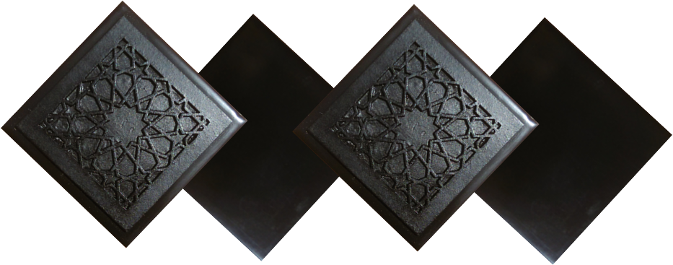
ABOUT OUR EMF PROTECTION PRODUCTS
SLEEPING PODS For a good nights sleep
HELP SUPPORT MARIA ZEEE BY SHOPPING FROM THIS LINK: https://www.ftwproject.com/ref/468/
CHARGE PLATES for use around the home, to preserve food and more
“We just can't believe our eyes! We have placed the garden pucks from our first order around our property, and the plants/trees with the pucks are BLOOMING within days! This is happening with every single place the pucks have been rested. Just incredible.” -Australia
PHONE SHIELDS to put on your cell phone, laptop and routers
PENDANTS for personal emf protection on your body
PYRAMIDS and garden sets for gridding your home / property / garden for emf protection on a large scale
SCIENTIFIC STUDIES AND DOCUMENTATION DESCRIBING HOW OUR PRODUCTS WORK AVAILABLE ON OUR WEBSITE.
TILES for incorporating emf protection into construction projects
WWW.FTWPROJECT.COM

